Slide 1
Computer Engineering
Generated for: Introduction to Operating Systems, Process Management, Memory Management
Notes:
Welcome to the Computer Engineering presentation covering multiple topics. Today we'll explore: Introduction to Operating Systems, Process Management, Memory Management.

Slide 2
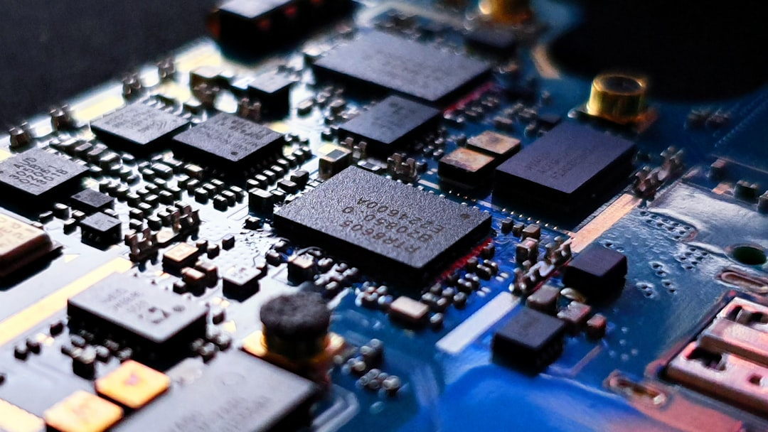
Introduction to Operating Systems: Fundamentals and Basics
Manages computer hardware and software resources efficiently always
Provides platform for running applications and services smoothly
Controls input output and storage devices effectively always
Handles memory management and allocation tasks precisely
Supports multitasking and multithreading capabilities fully
Ensures security and authentication mechanisms are implemented
Manages file systems and directory structures perfectly
Provides user interface and experience for interaction purposes
Optimizes system performance and responsiveness always
Notes:
Welcome to the introduction of operating systems, a crucial component of computer engineering. In this section, we will explore the basics and fundamentals of operating systems. We will discuss how they manage hardware and software resources, provide a platform for applications, and ensure security and authentication.

Slide 3

Introduction to Operating Systems: Fundamentals and Concepts
Manages computer hardware and software resources efficiently always
Provides a platform for running applications and services smoothly
Controls input output and storage devices effectively always
Manages memory and CPU allocation for optimal performance always
Ensures security and authentication for authorized access only
Supports multitasking and multithreading for increased productivity
Provides a user interface for interacting with the system easily
Handles interrupts and exceptions for seamless operation always
Optimizes system performance and responsiveness always
Enables communication between hardware and software components
Notes:
Welcome to the introduction of operating systems, a crucial component of computer engineering. In this section, we will explore the fundamentals and concepts of operating systems, including their role in managing hardware and software resources. We will also discuss the key features and functions of operating systems, such as memory management and security.

Slide 4
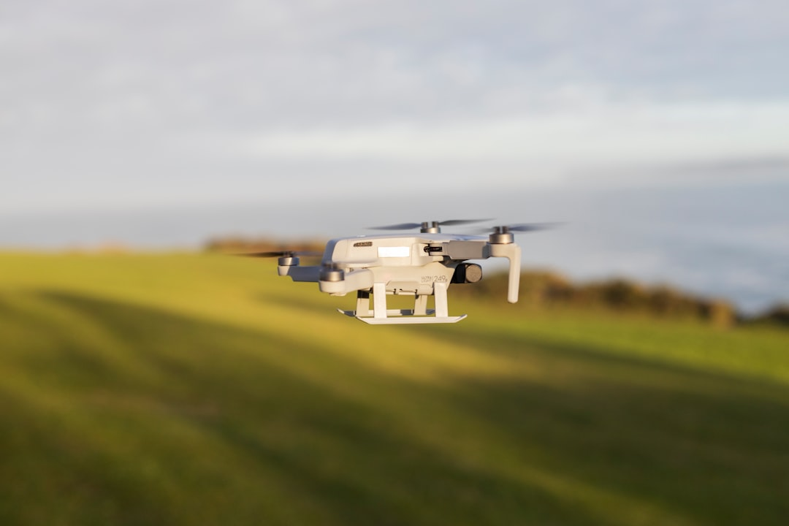
Introduction to Operating Systems: Fundamentals and Concepts
Manages computer hardware and software resources efficiently always
Acts as an intermediary between user and computer hardware components
Provides a platform for running application software programs smoothly
Controls input output and memory management functions effectively
Ensures security and integrity of computer system data always
Supports multitasking and multithreading capabilities seamlessly
Optimizes system performance and resource allocation always
Provides a user interface for interacting with computer systems easily
Manages files and directories in a systematic and organized manner
Notes:
In this section, we will introduce the basics of operating systems, including their role, functions, and characteristics. We will explore how operating systems manage computer hardware and software resources, provide a platform for running applications, and ensure system security and integrity. Key concepts such as multitasking, multithreading, and memory management will also be discussed.

